Slide 1
IBM University Engagement Project Submission
“Exploring the Power of Agentic AI with IBM Granite and IBM Bob”

Slide 2

Project Tile – Travel Planner
Domain of Project – Travel & Tourism
Student Name | Recent Passport Photo | Email ID | Mobile number [WhatsApp]
Ayushman Saxena |  | saxenanaman05@gmail.com | 9264988354

Slide 3
Problem Statement -
Problem Statement : Travel Planner Agent
The Challenge
Planning a trip can be time-consuming and complicated because travellers need to consider multiple factors such as destination, budget, travel duration, transportation, accommodation, sightseeing, food, and personal interests. Traditional travel-planning methods often require users to search across multiple platforms and manually organize information, making it difficult to create a plan that fits their specific needs.
The challenge is to develop an AI-powered Travel Planner Agent that can understand a traveller's requirements through natural conversation and generate a personalized, budget-conscious travel plan. The agent should be able to adapt the itinerary when the traveller changes their preferences, budget, duration, or other constraints.

Slide 4
Problem Statement -
Problem Statement : Travel Planner Agent
Objectives
Personalized Trip Planning – Generate travel plans based on the user's destination, budget, duration, interests, and preferences.
AI-Powered Recommendations – Use IBM Granite to generate intelligent suggestions for destinations, attractions, activities, food, transport, and accommodation.
Conversational Travel Assistance – Provide a natural, interactive experience through IBM watsonx Assistant, allowing users to plan trips through conversation.
Budget Optimization – Create itineraries that consider the user's budget and prioritize cost-effective travel options.
Dynamic Itinerary Modification – Allow users to change their budget, duration, preferences, or activities and automatically regenerate the itinerary.
User-Friendly Web Experience – Use IBM Bob to provide an attractive and easy-to-use website where users can interact with the Travel Planner Agent.
Efficient Travel Planning – Reduce the time and effort required to research and organize a complete trip manually.

Slide 5
Proposed Solution -
Proposed Solution: AI-Powered Travel Planner Agent
We propose an AI-powered Travel Planner Agent that provides a personalized and conversational travel-planning experience. The solution uses IBM Bob to build the interactive web interface, IBM watsonx Assistant to manage conversations with travellers, and IBM Granite to generate intelligent and personalized travel recommendations. The agent collects important travel requirements such as destination, starting location, duration, budget, number of travellers, interests, and travel preferences. Based on these inputs, IBM Granite generates a customized itinerary including day-wise activities, sightseeing recommendations, transportation options, accommodation suggestions, food experiences, and estimated expenses. Users can also modify their requirements during the conversation, allowing the agent to dynamically optimize and regenerate the travel plan. The solution is designed using IBM Cloud Lite services and demonstrates how IBM's AI technologies can transform complex travel planning into a simple, interactive, and personalized experience.

Slide 6
Technology Used
IBM watsonx Assistant – Used to build the conversational AI interface and manage interactions with travellers.
IBM Granite – Used as the core generative AI model to understand traveller requirements and generate personalized itineraries, recommendations, and travel plans.
IBM Cloud Lite Services – Used to develop, deploy, and support the cloud-based AI solution.
IBM Bob – Used to design and develop the interactive and user-friendly website/frontend for the Travel Planner Agent.
Web Technologies (HTML, CSS, JavaScript) – Used to create and customize the website interface and provide an engaging user experience.
Prompt Engineering – Used to structure traveller information and guide IBM Granite to generate relevant, personalized, and budget-conscious travel recommendations.

Slide 7
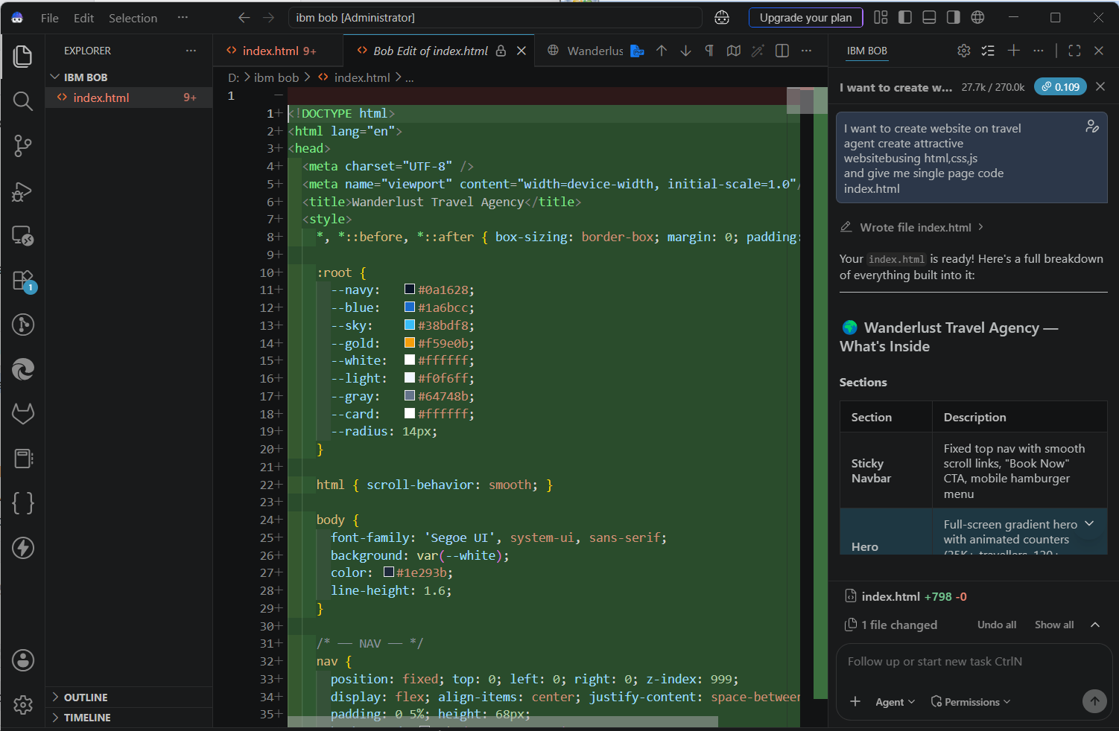
Required Files created using IBM bob -

Slide 8
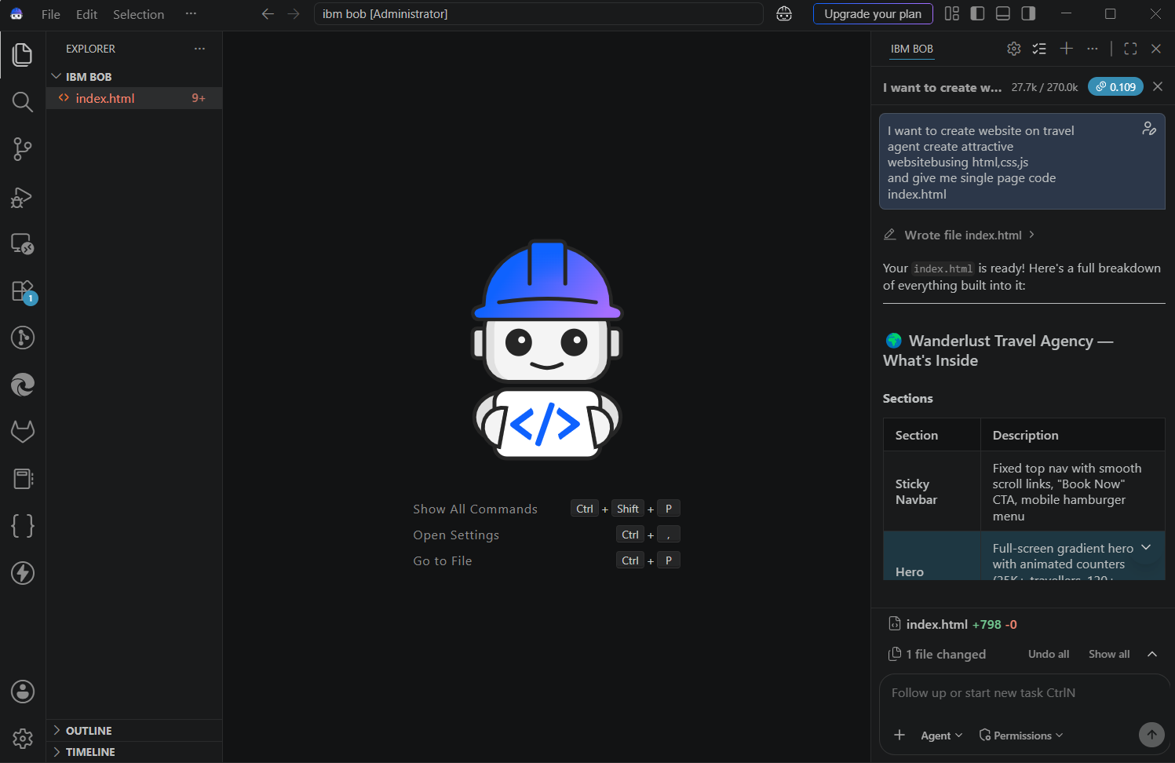
IBM Bob Screenshots:

Slide 9
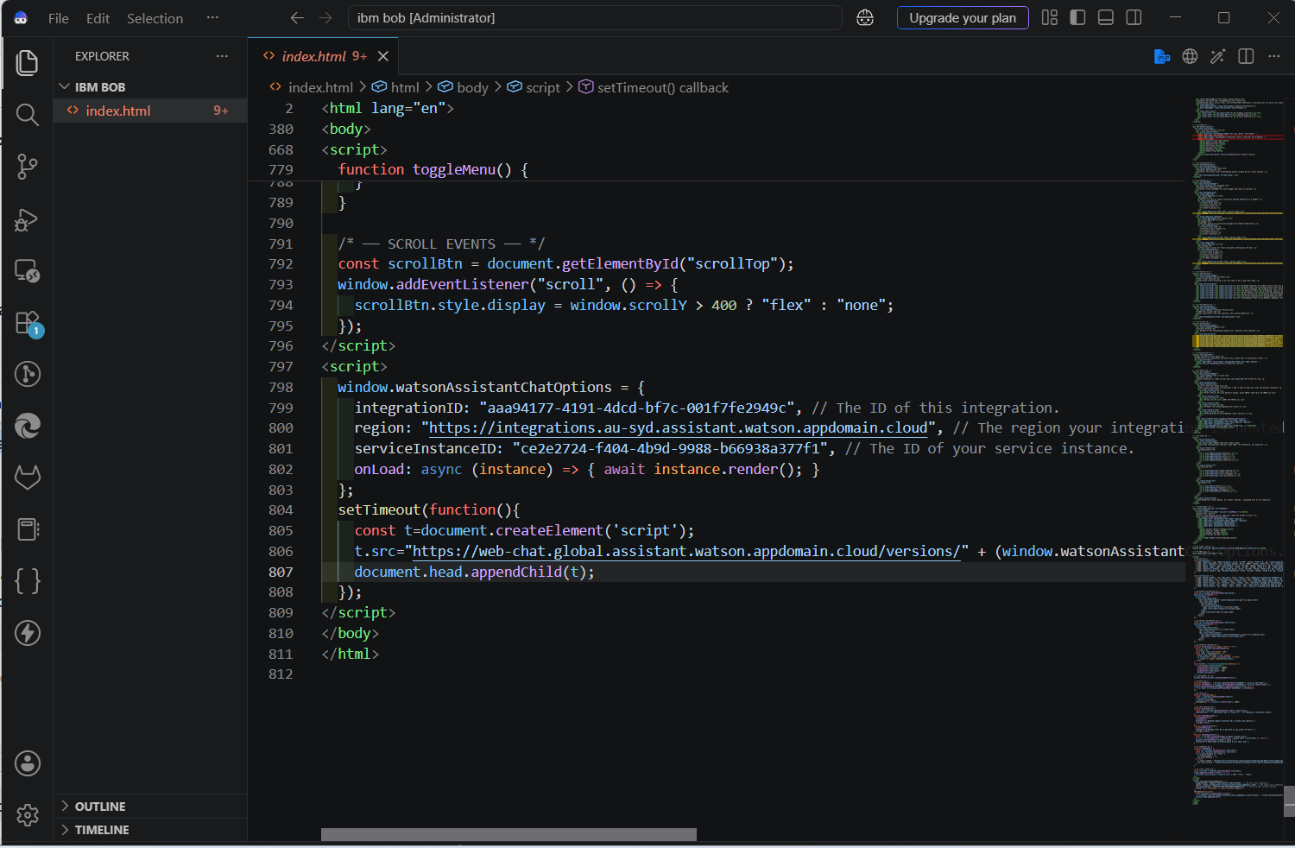

Slide 10
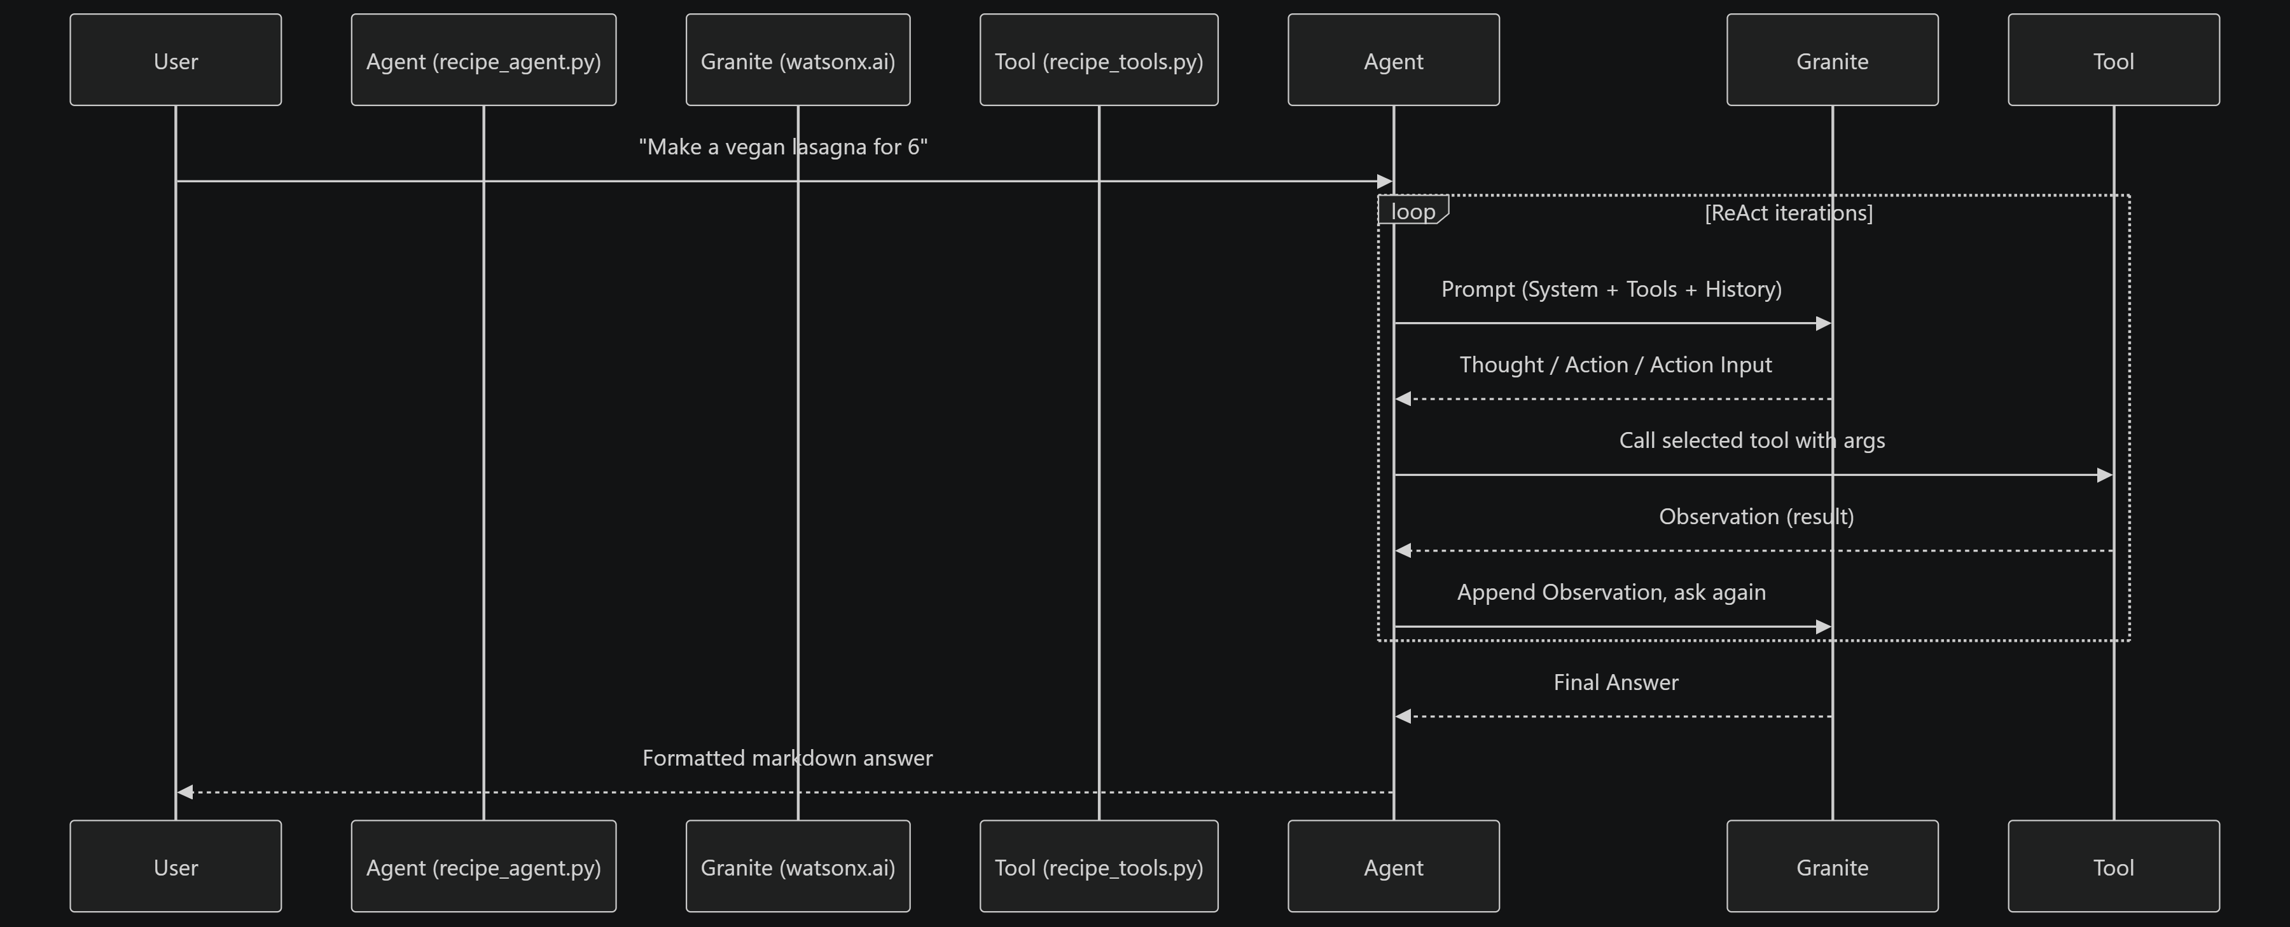
Architecture blueprint for IBM bob:

Slide 11

Role of Agentic AI in the solution
Role of Agentic AI in the Solution
Agentic AI plays a central role in transforming the Travel Planner from a simple chatbot into an intelligent travel-planning assistant. The agent understands the traveller's goals, collects relevant information, reasons over constraints, generates a suitable plan, and continuously adapts the itinerary based on user feedback.
Goal Understanding – Understands the traveller's objective, such as planning a 3-day trip to Mathura within a specific budget.
Intelligent Reasoning – Analyzes multiple factors including budget, duration, interests, number of travellers, and travel preferences to create a practical plan.
Autonomous Planning – Breaks the travel goal into smaller tasks such as sightseeing, transportation, accommodation, food, and daily scheduling.
Constraint Management – Balances the itinerary against constraints such as budget, available time, and traveller preferences.
Dynamic Adaptation – If the traveller says “reduce my budget,” “add one more day,” or “remove historical places,” the agent updates the plan instead of starting the conversation from scratch.
Context-Aware Interaction – Maintains the context of the conversation so travellers can communicate naturally through follow-up requests.
IBM Granite Integration – Uses IBM Granite to generate personalized recommendations, itineraries, and responses based on the information gathered by the agent.
User Interaction through IBM Bob – IBM Bob provides the web interface through which travellers interact with the agent in an intuitive manner.
Continuous Optimization – The agent can evaluate the current travel plan and propose improvements whenever the traveller's requirements change.

Slide 12
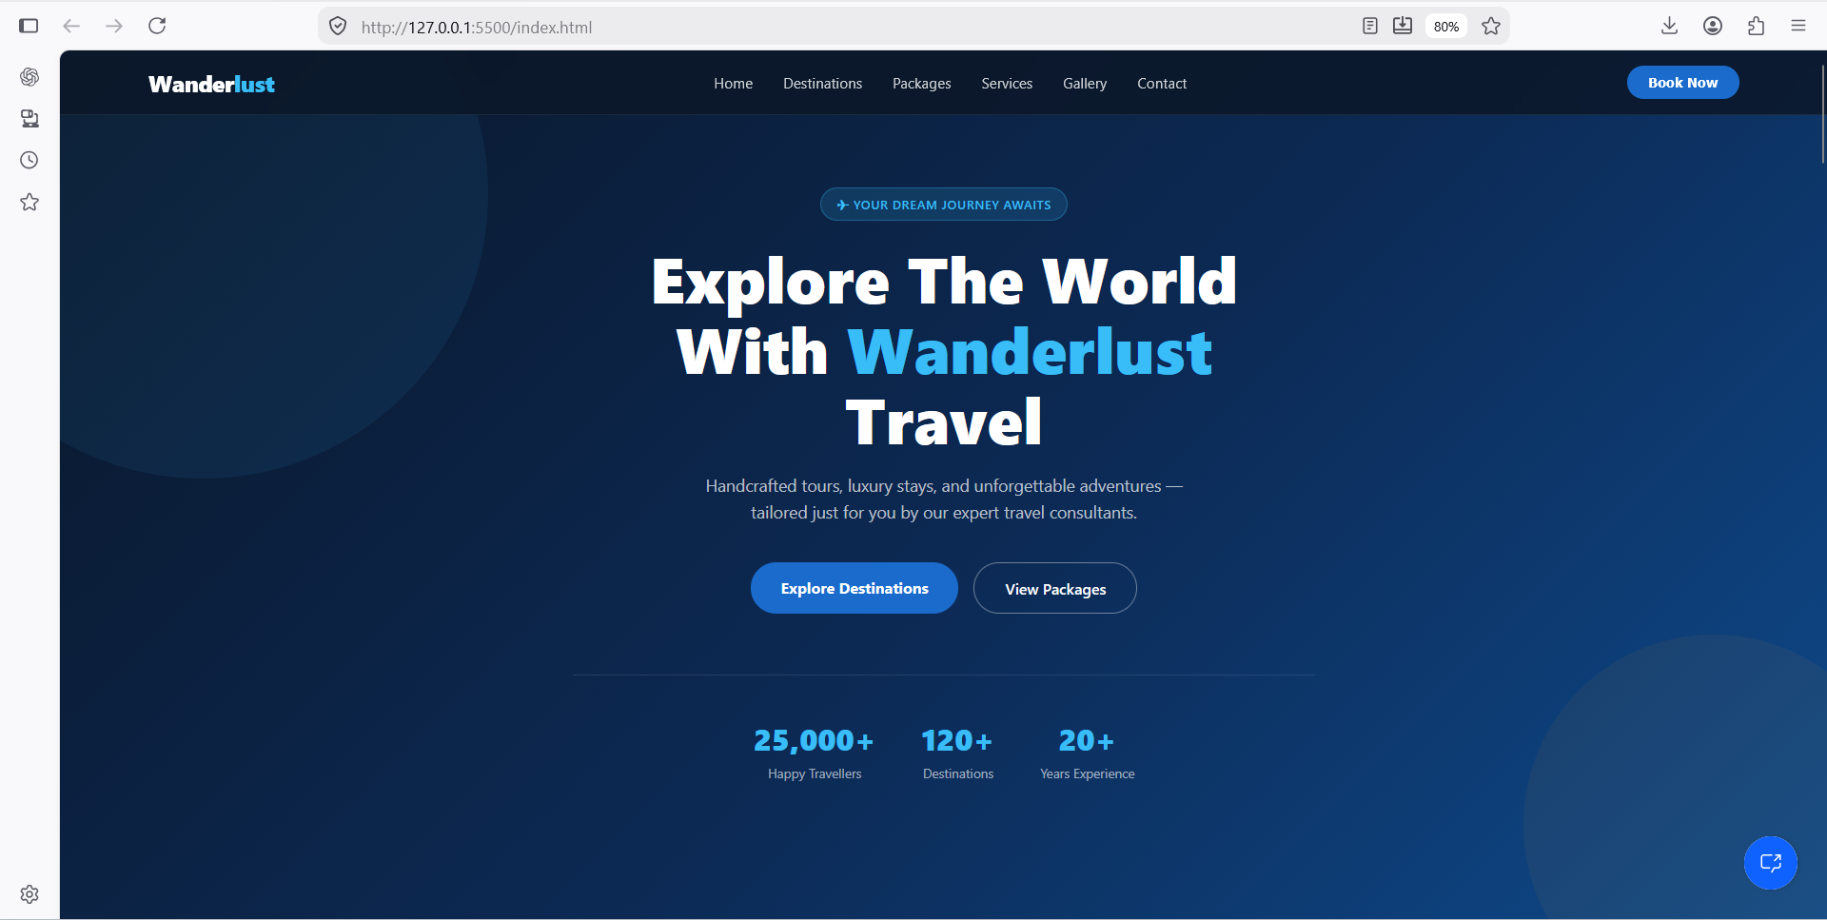
Project Output Screenshot
Please put IBM Bob output screenshots with 2-3 prompts.
You can take 2-3 more slides for each screenshot
·
·
·

Slide 13
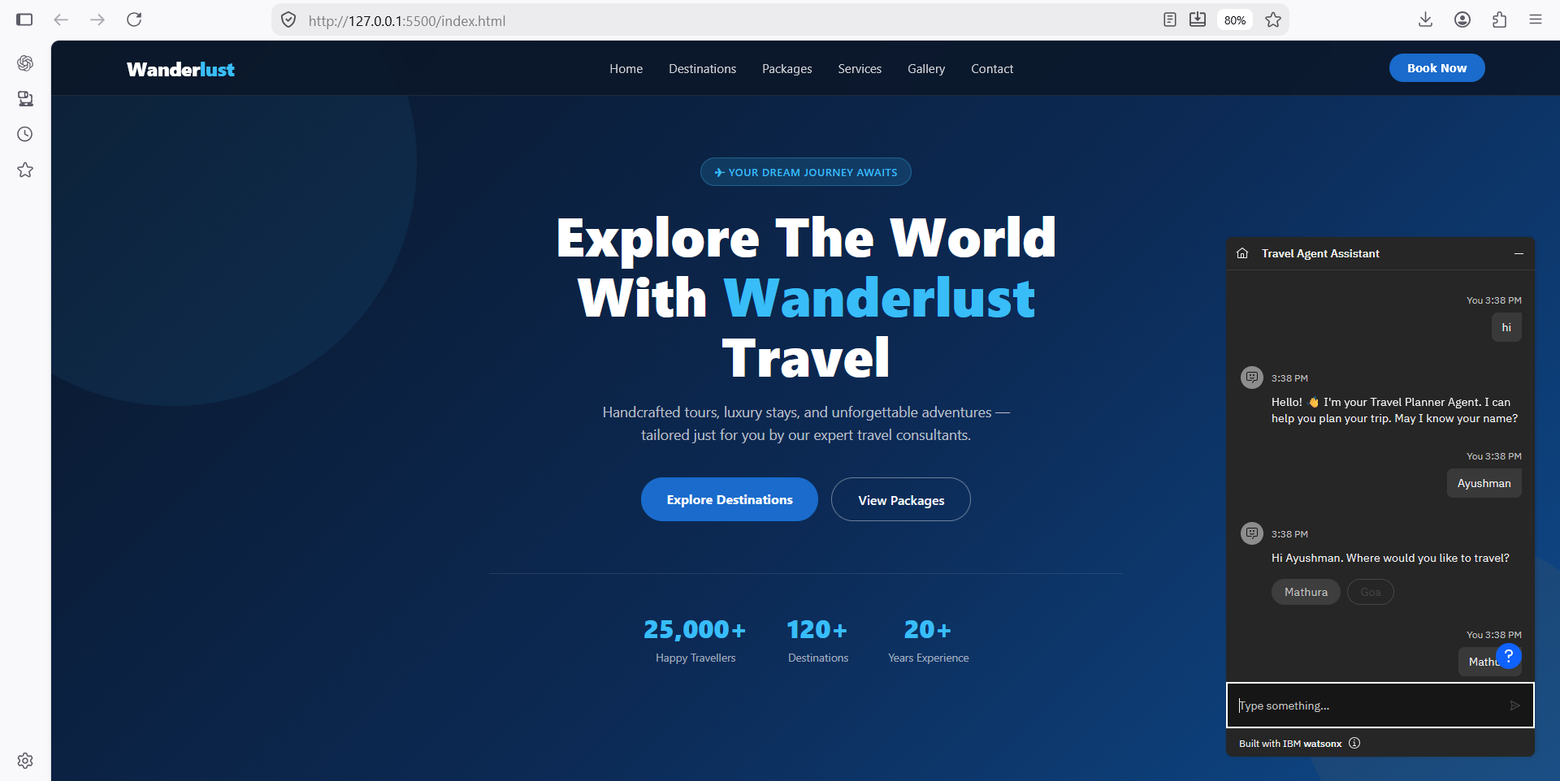
Project Output Screenshot
Please put IBM Bob output screenshots with 2-3 prompts.
You can take 2-3 more slides for each screenshot
·
·
·

Slide 14
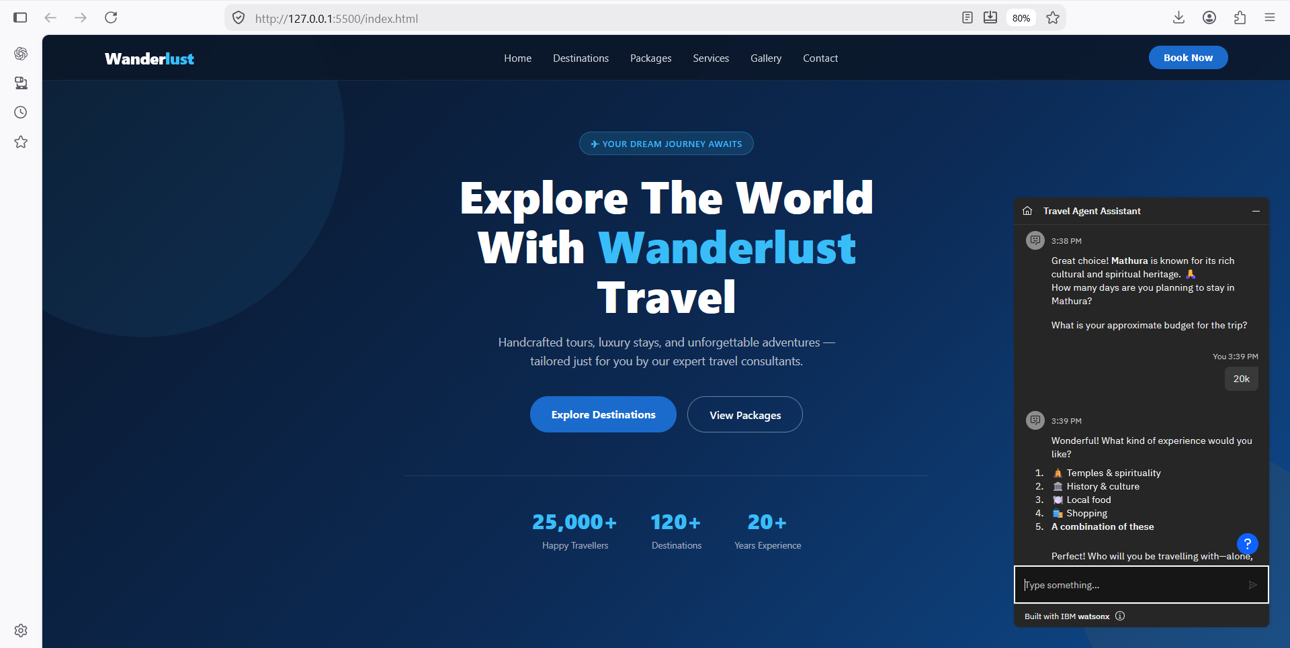
Project Output Screenshot
Please put IBM Bob output screenshots with 2-3 prompts.
You can take 2-3 more slides for each screenshot
·
·
·

Slide 15
Novelty and Uniqueness
Conversational Trip Planning: Travellers can simply describe their requirements in natural language instead of filling out complex forms or searching across multiple platforms.
Personalized Itinerary Generation: IBM Granite analyzes the traveller's destination, budget, duration, interests, and preferences to generate a customized day-wise itinerary.
Dynamic Plan Optimization: The itinerary is not static. If the traveller changes the budget, duration, interests, or activities, the agent can modify and regenerate the plan accordingly.
Budget-Aware Recommendations: The agent considers the traveller's budget while organizing transportation, accommodation, food, and activities, helping create a practical travel plan.
Context-Aware Conversation: The agent maintains the traveller's requirements throughout the conversation, allowing follow-up requests such as “make it cheaper,” “add one more day,” or “remove crowded places.”
IBM Granite-Powered Intelligence: Granite is used to transform collected travel preferences into meaningful recommendations and structured itineraries rather than using only predefined responses.
Interactive Web Experience: IBM Bob is used to create the user-friendly website interface, making the AI travel-planning experience accessible through a modern web application.
Integrated IBM Technology Stack: The combination of IBM Bob + IBM watsonx Assistant + IBM Granite + IBM Cloud Lite services creates an end-to-end AI travel-planning solution using IBM technologies.

Slide 16
Future Scope
The Travel Planner Agent can be further enhanced into a complete intelligent travel companion by adding advanced AI capabilities and real-time services.
Real-Time Weather Integration – Provide live weather conditions and forecasts for destinations and automatically adjust itineraries when weather conditions change.
Maps and Route Optimization – Integrate mapping services to calculate routes, travel times, distances, and optimize the order of attractions.
Booking Assistance – Extend the agent to assist with hotel, flight, train, bus, and activity bookings.
Real-Time Price Comparison – Compare transportation and accommodation prices to identify cost-effective options.
Smart Travel Alerts – Notify travellers about weather changes, delays, cancellations, schedule changes, and other important travel updates.
Multilingual Travel Assistance – Support multiple languages so travellers can communicate with the agent in their preferred language.
·
·
·

Slide 17
Git Hub Link
https://github.com/AyushmanSaxena/Travel-Planner
·
·
·

Slide 18
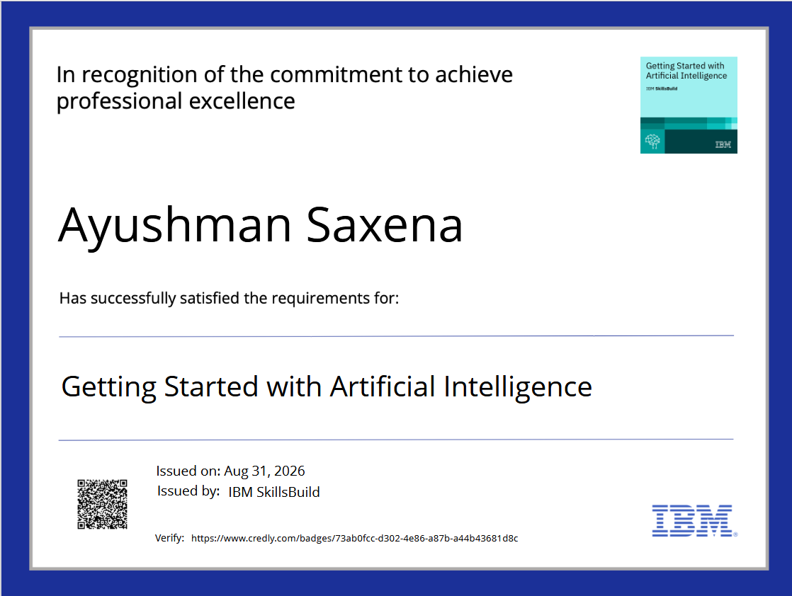
Certificates Earned:

Slide 19

Certificates Earned:​

Slide 20


